Slide 1
Intro to R: Mini Project
December 2020

Slide 2

Introductions!
Please share your name and a little about your current position/role!
What are you hoping to accomplish with R in the short term? Long term?

Slide 3
What makes a “good” project?

Slide 4
Coming up with a project
Keep it small! Smaller than you think.
Ideally, your program should perform one task
Think of some task you do regularly
Would it be accomplished faster if automated?
Would you get fewer errors?
Will there be less effort for you?

Slide 5
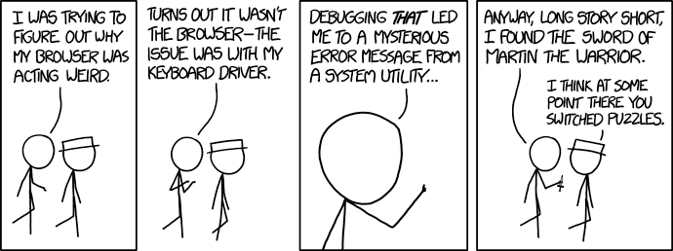
https://xkcd.com/1722/

Slide 6
How to Get Help When You Get Stuck

Slide 7

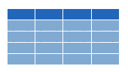

read_csv()
data frame to read data into
name of
CSV file
covid_testing <- read_csv("covid_testing.csv")
csv
Notes:
Recall from the workshop that you use the read_csv() function to load a CSV or comma separated value file into R’s memory.

Slide 8

read_excel()
data frame to read data into
name of
Excel file
covid_testing <- read_excel("covid_testing.xls")
xls
Notes:
I also wanted to let you know of a very similar function – read_excel, which loads excel files.
* This function is part of the readxl package, so you have to load it with library(readxl)

Slide 9
Your Turn
Suppose you want to import data from a file that’s similar to a CSV but uses vertical bars (|) instead of commas (,) as the separator between data fields.
Think about this for a minute then share your thoughts on how you would go about figuring out how to do this.
Notes:
So now that you’ve learned about two functions that can import files into R, consider the following scenario.

Slide 10
Notes:
Getting yourself un-stuck is such an important topic that I want to spend a little bit of time sharing with you what is a good approach.
This is the first overnight clinical pathology call I got back in July of 2014
- one of the oncologists at the MGH informs me that there's a new acute leukemia patient, and there is a flow cytometry tube
- so I called the clinician and asked how I could help, and he said, I just wanted to let the lab know.
- The problem is, that I was the lab, and being very new at all of this, I didn’t have the slightest idea what to do with that information. Do we immediately have to run the flow after-hours? Do I have to call in a tech? What are the next steps, and how do I decide how urgent this is?
- So I looked up the patient’s medical record, sure enough, it sounds like they have symptoms of leukemia; then I looked at our Pathology Resident Survival Guide, which didn’t say anything about after-hours flow. Then I tried find a relevant SOP, but didn't get anywhere.
- And after about 10 minutes, I ended up calling my hematopathology attending, told him everything I had learned about the patient and the situation and my question about how to triage after-hours leukemia flow, and he was able to walk me through what to do.
I think that when you’re a trainee, and you’re on call, you learn when you spend a limited amount of time actively looking for the answer, and then you ask for help.
If you give up right away and call your attending, then you don’t learn and your attending also thinks you’re lazy. If you spend too long trying to figure things out you could then whatever you do may be too late. So you want to be actively search your resources for a solution, but only for a limited amount of time, usually measured in minutes not hours, and then ask for help.

Slide 11
The Basic Approach to Getting Un-Stuck
Spend a limited amount of time actively looking for the solution
Ask for help
Step 1
Step 2
Notes:
And that is EXACTLY the same way you should approach problems when you’re coding.
Step 1 is Spend a limited amount of time actively looking for the solution.
And Step 2 is: Ask for help.
And you should have a process for actively looking for the solution, and I will talk about this in the next slides.
And you should also have a specific type of asking for help that makes is easy for the person you’re asking to figure out what’s going on, and I will also talk about that.
And this is how you learn coding. It’s that simple. Actually, this process is so fundamental to programming that most programmers don’t even realize that this is what they’re doing all day long. Writing some code, testing to see if it works or not, and figuring out how to fix it if it doesn’t is really all I do when I code.

Slide 12

Scenario 1: You get an Error
Is it really an Error?
Check spelling
Missing quotes, commas, parentheses
Misspelled function names, Capitalization!
Read the error message and try to make sense of it
Google the error message (cut + paste)
Ask for help* using the following template:
I tried to accomplish (goal) so I tried this code: …
I expected this: …
But instead I got this result/error: …
I’m running R/RStudio on (operating system).
*CHOP R User Group Slack (preferred!) or e-mail
Notes:
There are two common scenarios for getting stuck coding, and I promised to give you a process that I'd like you to think of to deal with them.
The first scenario is that you write some code and get an unexpected result or error message.
When you run code, and there is an error, R will tell you in bright red letters in the console that there is an Error. Actually, the first thing you should do is to make sure it’s actually an error or just a warning or message. If there is an error, the code stops executing, and it will say the word “Error” in the red message in your console. If there is red letters in the console and it DOESN’T say the word error, it’s just a warning or a message – remember when we made a histogram of covid_testing volumes, and there was a warning stating that we should define bin width? So that’s a useful thing to know but doesn’t mean that there is an error.
Go there and check for spelling errors first - missing quotes, commas, or parentheses, and misspelled function names. are extremely common sources of errors.
Then, actually read the error message. It may be cryptic but often you might find a clue in there that helps point at the problem.
Then, cut and paste the error message into Google. This is a powerful way to find solutions to common problems.
When all of these steps fail, you're done actively looking for the solution, so it's time to ask for help, usually by emailing someone who knows more R than you. Here is formula that makes it easy for that person to help you.
...

Slide 13
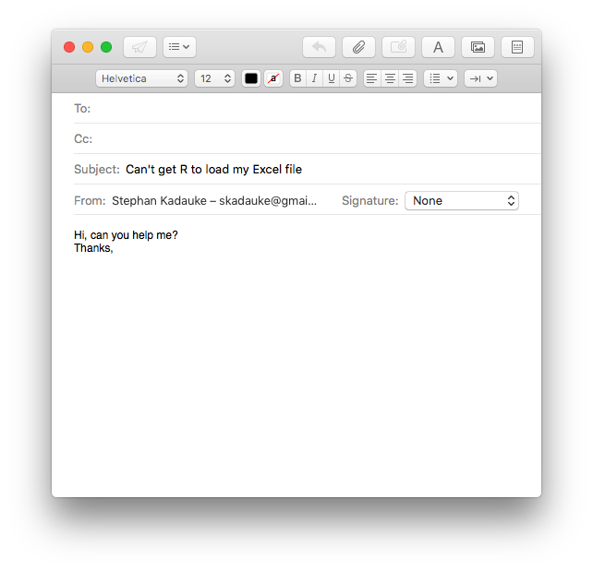
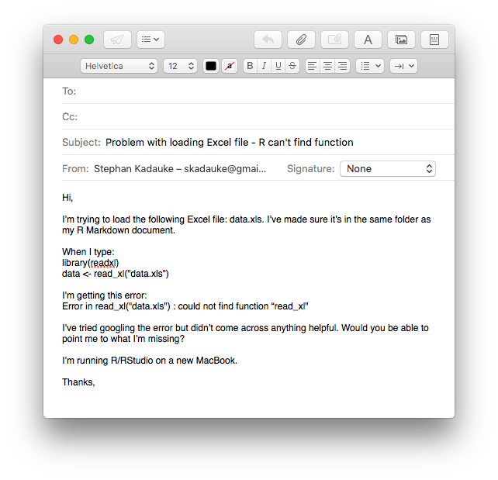
Notes:
To illustrate the power of this recipe, consider this email, which is similar to many emails I've gotten before.
...
This email gives me very little information about the problem that this person is encountering. I also don’t know what that person has already tried to solve the problem, but my guess is not very much.
* Consider this email, in contrast.
...
This email gives me a lot more to work with, importantly the code that was entered, and the error message. It also gives me an idea of what this person tried to do to fix the problem. Because the code and the error message are provided, I can actually tell immediately what the problem is, namely the function name read_excel is misspelled (should be e-x-c-e-l not x-l), which is a easy mistake to make, and can be hard to find by googling.
I am much more likely to write a helpful answer to the second email than to the first.

Slide 14
Demo: Common Errors
Notes:
Have an R Markdown file demonstrating
Warnings vs errors:
Package ‘tidyverse’ built under R version X.X.X
E.g.: library(tidyverse)
Common types of errors:
Could not find function
Object not found
Make people spot different types of mistakes:
Capitalization
Missing parenthesis (e.g., in ggplot call)
Missing comma (e.g., mutate)
Missing pipe
Library not loaded
Object not captured
Demonstrate troubleshooting techniques:
Troubleshoot a pipe by running one line at a time
Restart R. Often.
Take a break and do something else.
https://bookdown.org/yih_huynh/Guide-to-R-Book/trouble.html

Slide 15

Scenario 2: You Know What You Want to Do But Don’t Know How to Do it in R
Use the R built-in help
RStudio Cheat Sheets
Google
Extremely powerful
Be specific! ”rename a column in R with tidyverse”
Ask for help (on CHOP R Slack!)
Do an online tutorial!
?function
Notes:
The second scenario is that you think you know *what* you want to do but don't know *how* to do it in R.
There's a built-in help in R that we'll look at in a moment. This is useful if you think you already know the function you want to use but want to learn how to use it for a specific purpose.
RStudio makes cheat sheets, and we'll look at an example in a moment.
Google – extremely powerful. To get the best results, be specific! Let Google know that you’re using R and, if applicable, the tidyverse.
If you feel that there are some basic knowledge that you need to brush up on before even tackling a problem, online tutorials are the best way to go. We'll look at tutorials shortly.

Slide 16
Demo: Find Help
Notes:
R help [demo read_excel]
Rstudio Cheat Sheets [answer the question from the prompt here]
Googling: add “tidyverse” or “dplyr” or “with R”. E.g.: “rename a column in R with tidyverse”
Ask a question on Slack
Primers

Slide 17
Resources

Slide 18
Useful tools
R for Data Science, by Hadley Wickham & Garrett Grolemund (https://r4ds.had.co.nz/)
RStudio cheatsheets: https://rstudio.com/resources/cheatsheets/
RStudio primers: https://rstudio.cloud/learn/primers
The Arcus Education website: https://education.arcus.chop.edu/

Slide 19
Useful tools
R bootcamp (interactive lessons): https://r-bootcamp.netlify.app/chapter1
For more resources, revisit the course website: https://skadauke.github.io/intro-to-r-for-clinicians-chop/
If you find more resources that you like, be sure to share!

Slide 20
Presenting Your Hard Work!

Slide 21
Presentations
We ask that everyone give a brief presentation at a future CHOP R User Group meeting (date TBD, estimated ~3 months from now)
Talk about your topic and how you used R to complete the task
A helpful R Markdown template to get started: https://github.com/skadauke/intro-to-r-for-clinicians-chop/blob/master/exercises/r_project_template.md

Slide 22
Questions?

